Slide 1
Water Temperature controller Unit

Slide 2
Introduction
All Engines ( 4 stroke & 2 stroke )required some form of temperature control in order that they do not overheat & seize .some engines are air cooled whilst other are water cooled.
Larger Engines are water cooled.
Water can remove more heat than air & thus has larger cooling capacity
Water can cooled remotely by using cooling water system
A cooling water temperature of approximately 80 ℃ & cooling water pressure of 3 bar is standard for most engines operating under load .

Slide 3
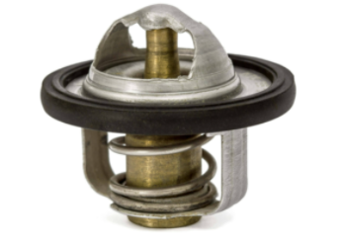
Thermostate
A thermostat is a temperature-sensing device that measures the temperature of engine coolant. The component is designed to know when to open and close so that internal combustion engines can work at an efficient temperature.
Thermostats remain close if the coolant is not hot enough. But if the coolant reaches a specific temperature, it opens, allowing the flow of hot coolant into the radiator. So, the thermostat is just like a gate that allows or blocks the flow of coolant from the engine to the radiator.
Modern car engines work at a certain range of temperature, normally, the engine work at 80 degrees Celsius and The thermostat senses the coolant temperature and determined when to open and close.

Slide 4
Functions of Thermostat
Below are the major functions of thermostat used in the engine cooling system:
The primary function of a thermostat is to control the working temperature of the engine.
With the component, the engine is prevented from overheating and excess cooling.
At cold start, thermostat blocks the coolant to flow. This cause the engine to reach its working temperature faster.
Also, it ensures coolant absorbs heat before entering the radiator.
Finally, thermostat controls the circulation of coolant in the overall engine

Slide 5
Working Principle
To most newbie in the auto industry, the working of a thermostat can be so magical. But the fact that is less complex and can be easily understood. Just as earlier mentioned the components are located between the engine and radiator in the internal parts. So, from the radiator coolant passes through the down hose of it to the engine. This where the coolant absorbs heat.
However, the engine also has to work at a specific temperature so efficient working can be achieved. This is why the thermostat is needed, just imagine there is no thermostat in an engine and coolant flows to absorb heat produce. The vehicle might event stop working since the heat from the combustion process is taken by the coolant. But, if there is a thermostat, the flow of the coolant is blocked until the coolant get heated to some specific temperature where the device needs to open. With this engine work at the right temperature and will not overheat as well as undercool.

Slide 6
Water temperature controller unit
Aimed to provide coolant at controlled flow rate, temperature and pressure to the engine water jacket. The hot water from engine passes through the tube inside of heat exchanger and is cooled down before returning to the engine again. The position of control valve spindle decides the amount of shop (cooling) water going through shell side of the heat exchanger. A temperature sensor (PT 100) senses the temperature of water going to / coming out of the engine jacket. Process Controller controls the position of valve spindle depending on difference in the actual temp and the set temp, trend of temperature change (rise / fall), speed of temperature change, etc.

Slide 7
The system essentially comprises:
Heat Exchanger
Motorized Valve
Circulation Pump
Drain Pump
SS In-cell Tank with level switch & level gauge
Filters at inlet of the tank, inlet of the engine and in the drain circuits
Heater
Temperature Control for Heater & engine water out temperature with sensors
Ball Valves, NRVs, pressure gauges, piping, etc.
Here, the raw water is used for controlled heat removal from the engine so as to maintain coolant outlet temperature say at 80 C. (settable range 80 oC ~ 95 oC)
Initial heating of coolant at 70 oC with auto timer so that engine is filled with hot coolant; insulated, hot water storage tank with level control, visual glass tube level indicator, over flow and drain, auto & manual filling provision.
Following Auto functions are provided:
Engine filling,
External pump to assist engines own pump.
Drain,
Blow-down with compressed air

Slide 8
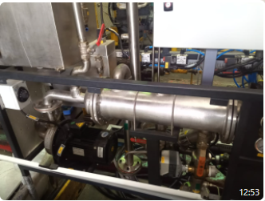

Slide 9
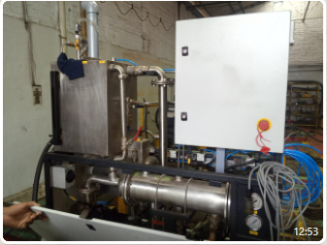

Slide 10
